Slide 1


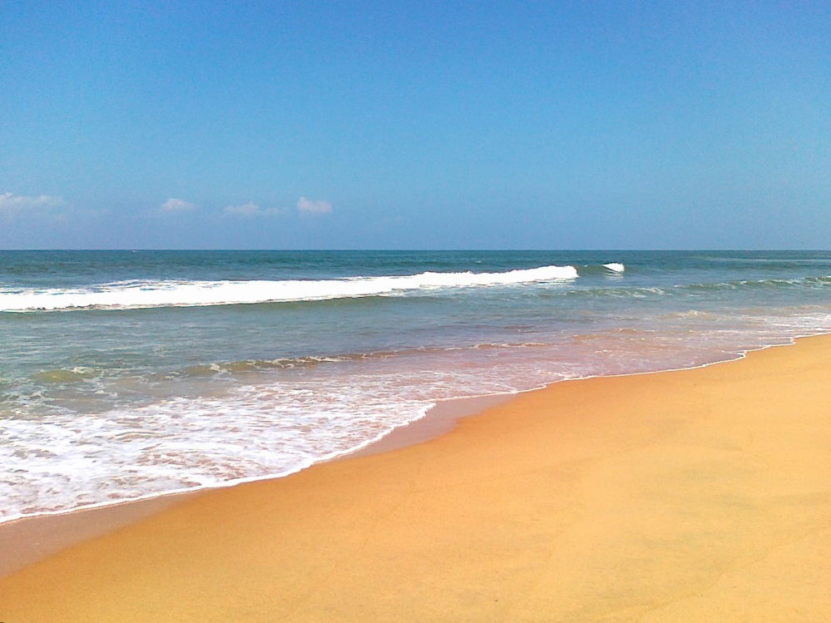
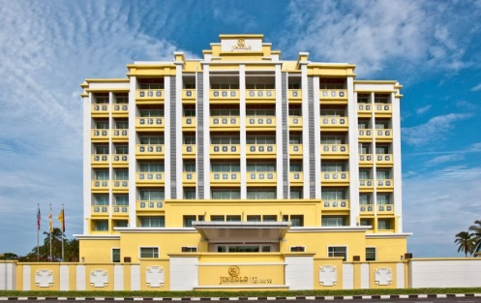

Capstone Project: Massachusetts, Florida, and North Carolina Beaches and Nearby Venues

Slide 2
Introduction
In this project, I examine the similarities and differences of beach locations in Cape Cod (Massachusetts), Naples (Florida), and Ocean Isle Beach (North Carolina).
This project would appeal to people interested in visiting a beach who are choosing the location of their trip based on the venues nearby.
If you were looking to go on vacation in any month, what would be the best place to visit? If you were looking to rent or purchase a house year-round, where should you look? Depending on your lifestyle and interests, what is the best place to go?

Slide 3

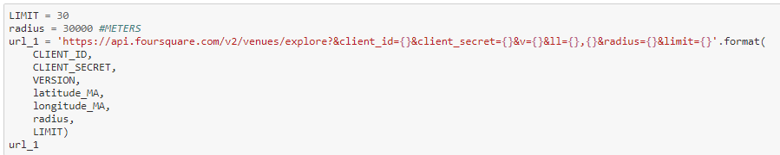
Data
To complete the project, I used Foursquare location data from Cape Cod, Naples, and Ocean Isle Beach.
For each location, I examined 30 venues within a radius of 30,000 meters.
This Foursquare location data was used to search nearby venues of these 3 locations and rank the most common venues of the nearby cities.

Slide 4
Methodology
Massachusetts is a location with temperatures that range from around 20 degrees Fahrenheit in the winter months to over 80 degrees Fahrenheit in summer. From this initial information, I speculated that Cape Cod would have more activities for seasonal tourists.
Florida is a location with warm and hot temperatures year-round. From this initial information, I wondered if Florida would have more venues than Cape Cod, since the warm-weather activities can be enjoyed year-round.
North Carolina is a location with weather similar to Massachusetts, but with slightly warmer winter months. From this initial information, I guessed that North Carolina would lie somewhere in-between Florida and Massachusetts in terms of its venues.
First, for this project, I read the results of each Foursquare search into a dataframe and cleaned it so that it listed the name of the venue, its category, latitude and longitude, and city. I grouped each dataframe by city and counted the number of locations in each category. Then, I used onehot encoding to calculate the frequencies of each venue category in each city so that ultimately I could have a dataframe that listed the nearby cities and the 10 most common venues in each city.
To understand where the venues were in reference to each other, I clustered each set of data and plotted them on their maps. This machine learning technique allows us to see if the venues are near each other and help us decide if that location is worth going to, since if the venues are too far apart someone on vacation wouldn’t necessarily be willing to travel a far distance.

Slide 5
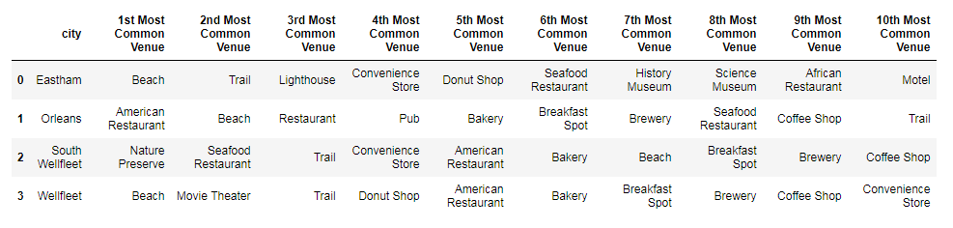
Results – Cape Cod (Massachusetts)
For Massachusetts, we see that there are 4 cities within our radius. For the 4 cities, the 1st most common venues are beaches, American restaurants, and nature preserves. Overall, common venues for Cape Cod include beaches, restaurants, convenience stores, and tourist activities.

Slide 6
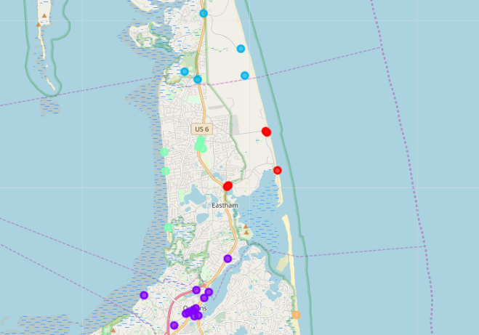
Results – Cape Cod (Massachusetts)
From our cluster map, we see that venues are clustered near each other, but overall the clusters span a wide range.

Slide 7
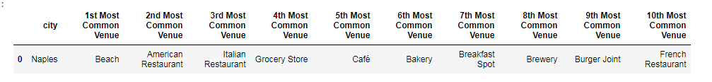
Results – Naples (Florida)
For Florida, the most common venue is beaches. Other venues include restaurants and grocery stores.

Slide 8
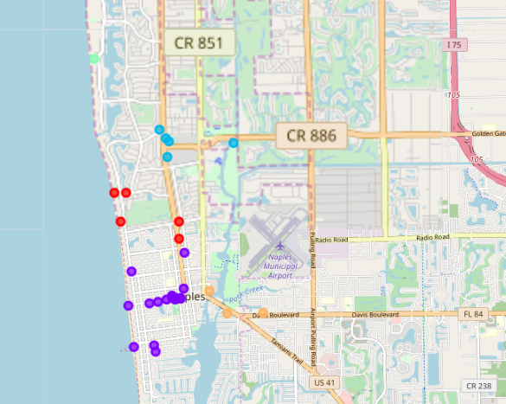
Results – Naples (Florida)
From our cluster map, we see that venues are very close together.

Slide 9
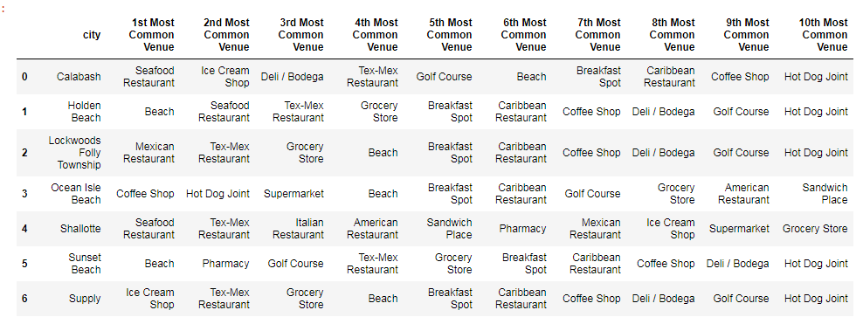
Results – Ocean Isle Beach (North Carolina)
For North Carolina, there are 7 cities within our radius. The 1st most common venues are seafood restaurants, beaches, Mexican restaurants, coffee shops, and ice cream shops. Overall, common venues for North Carolina include beaches, grocery stores, restaurants, and tourist activities.

Slide 10
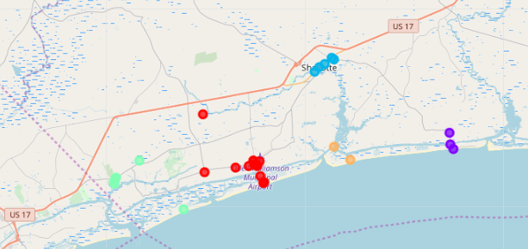
Results – Ocean Isle Beach (North Carolina)
From our cluster map, we see that venues are very close together.

Slide 11
Discussion
1. If you were looking to go on vacation in any month, what would be the best place to visit?
Any of the three locations would be sufficient for a summer vacation, based on the venues that we discovered using our Foursquare location data. Examining the results deeper, we see that Cape Cod houses a wide variety of restaurants, shops, and beaches. Cape Cod also has convenience stores, which would be useful for someone on vacation.
However, the venues of Cape Cod are too spread out, since someone on vacation may not necessarily have a car with them. Additionally, Cape Cod would only be an ideal beach vacation in the summer months, since Massachusetts faces cold weather and snow in winter. Similarly, although North Carolina has several appealing venues conveniently close to each other, you could only take a beach vacation there in the summer months.
Naples would be the best spot out of the three, since it has warm weather year-round, has several restaurants and beaches, and has many venues nearby each other.

Slide 12
Discussion
2. If you were looking to rent or purchase a house year-round, where should you look?
Naples would also be the best place to rent or purchase a house year-round, for the same reasons as the answer to question 1. Additionally, Naples has grocery stores, which would appeal to someone with a house more than a convenience store would.

Slide 13
Discussion
3. Depending on your lifestyle and interests, what is the best place to go?
Although Naples was the winner of the first two questions, it does not have as wide a variety of venues as North Carolina and Cape Cod do. Naples mainly features beaches and very similar food locations. North Carolina also features mostly food locations, but it has a very wide variety to choose from. Lastly, Cape Cod has venues that would suit someone choosing a location based on tourist activities. Cape Cod has trails, movie theaters, and museums, which makes it much better to visit based on variety of tourist attractions.

Slide 14
Conclusion
From the Foursquare location data and JupyterLabs notebooks we have the ability to see what venues are nearby a location and where they cluster around that location, allowing us to choose the best spot to fit our needs.
If you are someone who would like to visit a beach at any point in the year, it would be best to choose Naples, Florida. If you are someone who loves a variety of foods, it would be best to visit the beaches of North Carolina. And, if you are someone who likes the beach but also wants to explore other attractions, you should take a trip to Cape Cod, Massachusetts.
From our cluster maps, we can see that if you were to visit Naples or North Carolina, the venue clusters would be within walking distance. For Cape Cod, it may be best to have a car with you so that you can visit the different clusters of venues.
Overall, no matter what your preferences are for your trip, the information you need is easily accessible and available to you through Foursquare and JupyterLabs so that you can make the best decision for your situation.

